Slide 1
Introduction to Microeconomics

Slide 2
Lecture 14 Production and Costs

Slide 3
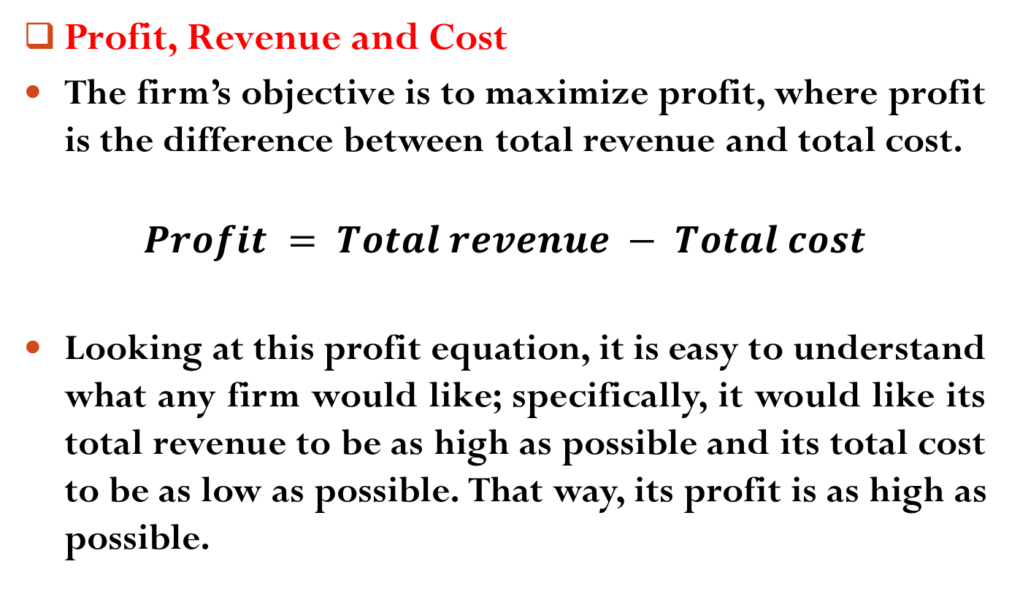
Production and Costs
Profit, Revenue and Cost
The firm’s objective is to maximize profit, where profit is the difference between total revenue and total cost.
$$Profit = Total revenue − Total cost$$
Looking at this profit equation, it is easy to understand what any firm would like; specifically, it would like its total revenue to be as high as possible and its total cost to be as low as possible. That way, its profit is as high as possible.

Slide 4
Production and Costs
Profit, Revenue and Cost
Total revenue is equal to the price of a good multiplied by the quantity of the good sold.
Total cost is the summation of explicit cost and implicit cost.
An explicit cost is a cost that is incurred when an actual (monetary) payment is made. On the contrary, An implicit cost is a cost that represents the value of resources used in production for which no actual (monetary) payment is made.

Slide 5
Production and Costs
Example
Suppose Jill currently works as an attorney earning $80,000 a year. One day, dissatisfied with her career, Jill quits her job as an attorney and opens a pizzeria.
After one year of operating the pizzeria, Jill sits down to compute her profit. She sold 20,000 pizzas at a price of $10 per pizza; so her total revenue (for the year) is $200,000.
Jill computes her total costs by adding the dollar amounts she spent for everything she bought or rented to run the pizzeria. She spent $2,000 on plates, $3,000 on cheese, $4,000 on soda, $20,000 for rent in the mall where the pizzeria is located, $2,000 for electricity, and so on.

Slide 6
Production and Costs
Example
The dollar payments Jill made for everything she bought or rented are called her explicit costs. So Jill sums her explicit costs, which turn out to be $90,000.
Jill’s $80,000 salary is what economists call an implicit costs - “What you could have earned but didn’t is a cost to you of running the pizzeria”.

Slide 7
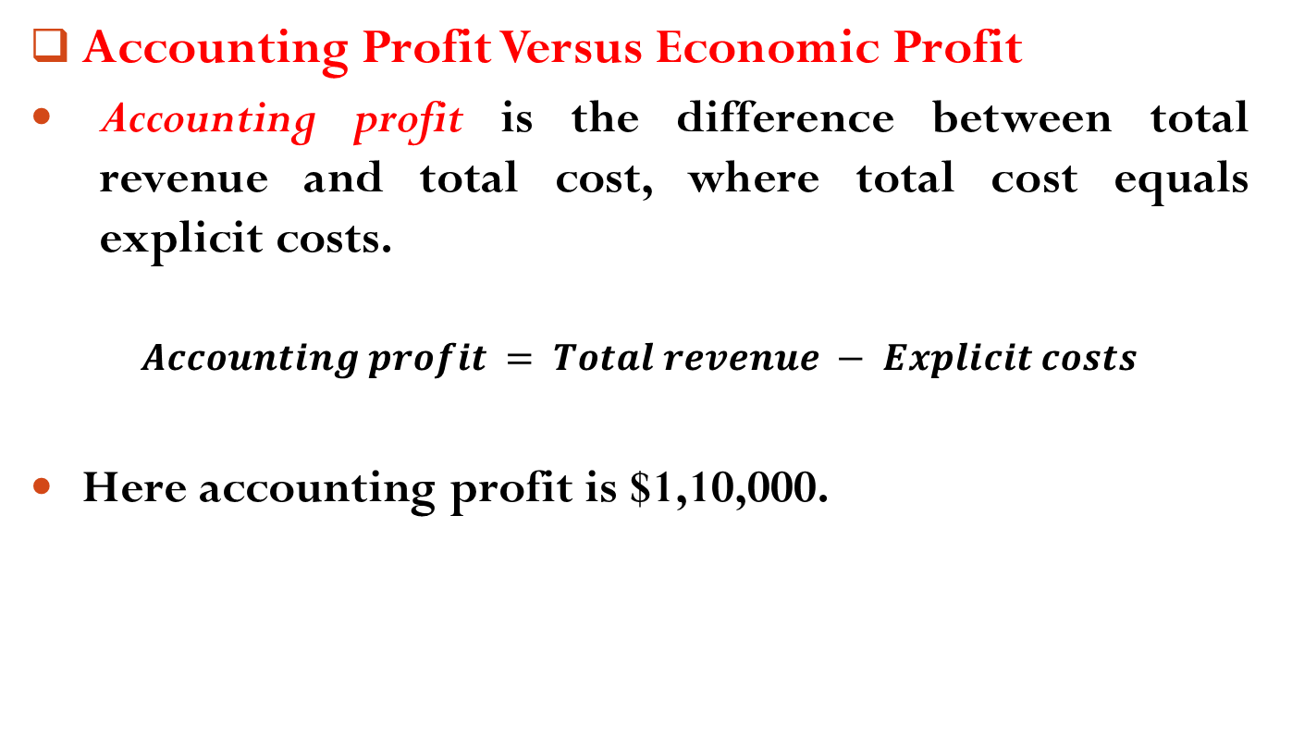
Production and Costs
Accounting Profit Versus Economic Profit
Accounting profit is the difference between total revenue and total cost, where total cost equals explicit costs.
$$Accounting profit = Total revenue − Explicit costs$$
Here accounting profit is $1,10,000.

Slide 8
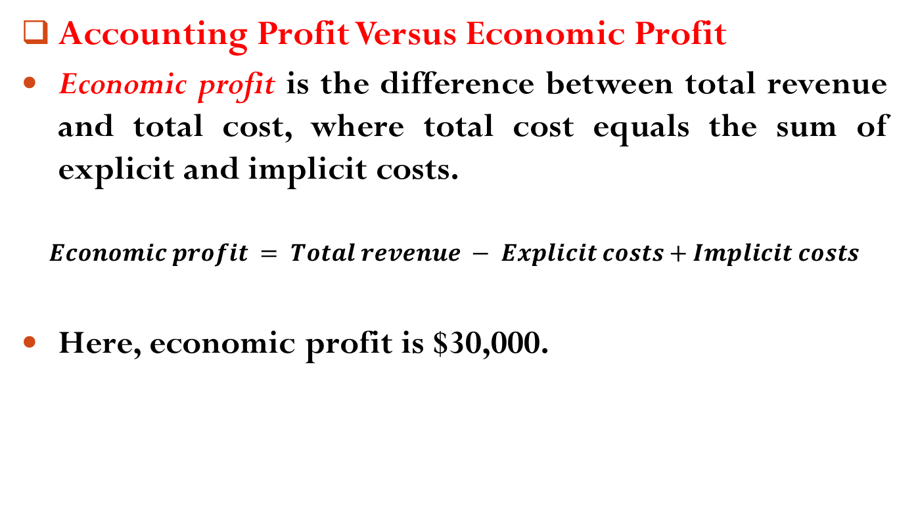
Production and Costs
Accounting Profit Versus Economic Profit
Economic profit is the difference between total revenue and total cost, where total cost equals the sum of explicit and implicit costs.
$$Economic profit = Total revenue − Explicit costs+Implicit costs$$
Here, economic profit is $30,000.

Slide 9
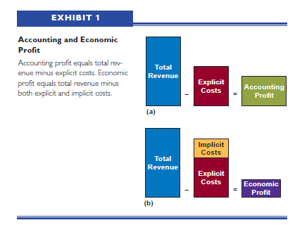
Production and Costs
Accounting Profit Versus Economic Profit

Slide 10
Production and Costs
Production
Production is a transformation of resources or inputs into goods and services.
Economists often talk about two types of inputs in the production process: fixed input and variable input.
A fixed input is an input whose quantity cannot be changed as output changes.

Slide 11
Production and Costs
Production
To illustrate, suppose the McMahon and McGee Bookshelf Company has rented a factory under a six-month lease: McMahon and McGee, the owners of the company, have contracted to pay the $2,500 monthly rent for six months—no matter what.
Whether McMahon and McGee produce one bookshelf or 7,000, the $2,500 rent for the factory must be paid.
The factory is a fixed input in the production process of bookshelves.

Slide 12
Production and Costs
Production
A variable input is an input whose quantity can be changed as output changes.
Examples of variable inputs for the McMahon and McGee Bookshelf Company include wood, paint, nails, and so on.
Labor might also be a variable input for McMahon and McGee. As they produce more bookshelves, they might hire more employees; as they produce fewer bookshelves, they might lay off some.

Slide 13
Production and Costs
The Short Run and the Long Run
If any of the inputs of a firm are fixed inputs, then it is said to be producing in the short run.
In other words, the short run is a period of time in which some inputs are fixed.
If none of the inputs of a firm is a fixed input—if all inputs are variable—then the firm is said to be producing in the long run.
In other words, the long run is a period of time in which all inputs can be varied (no inputs are fixed).

Slide 14
Production and Costs
Production in the Short Run
Suppose two inputs (or resources), labor (L) and capital (C ), are used to produce some good.
Furthermore, suppose one of those inputs—capital—is fixed. Obviously, because an input is fixed, the firm is producing in the short run.
In Exhibit 2, column 1 shows the units of the fixed input, capital (fixed at 1 unit) and Column 2 shows different units of the variable input, labor.

Slide 15
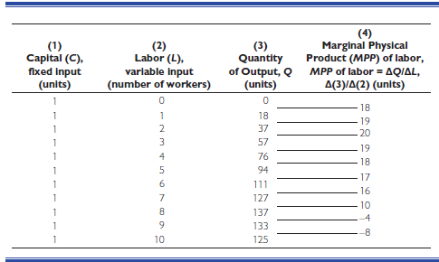
Production and Costs
Production in the Short Run

Slide 16
Production and Costs
Production in the Short Run
Column 3 shows the quantities of output produced with 1 unit of capital and different amounts of labor. (The quantity of output is sometimes referred to as the total physical product, or TPP.)
For example, 1 unit of capital and 0 units of labor produce 0 output; 1 unit of capital and 1 unit of labor produce 18 units of output; 1 unit of capital and 2 units of labor produce 37 units of output; 1 unit of capital and 3 units of labor produce 57 units of output; and so on.

Slide 17
Production and Costs
Production in the Short Run

Slide 18
Production and Costs
Production in the Short Run
Column 4 shows the marginal physical product of the variable input. The marginal physical product (MPP) of a variable input is equal to the change in output that results from changing the variable input by one unit, holding all other inputs fixed.
Because in our example the variable input is labor, we are talking about the MPP of labor.
Specifically, the MPP of labor is equal to the change in output, Q, that results from changing labor, L, by one unit, holding all other inputs fixed.

Slide 19
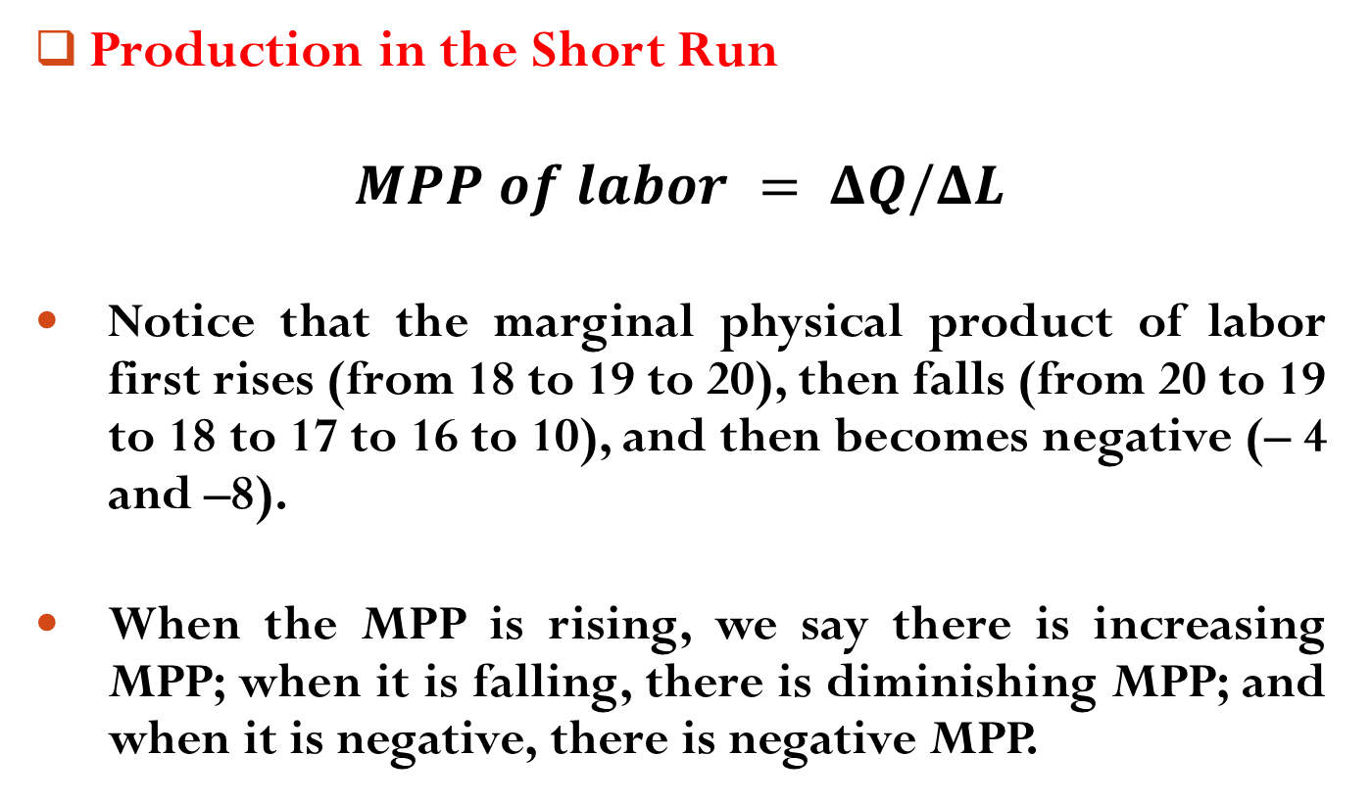
Production and Costs
Production in the Short Run
$$MPP of labor = ΔQ/ΔL$$
Notice that the marginal physical product of labor first rises (from 18 to 19 to 20), then falls (from 20 to 19 to 18 to 17 to 16 to 10), and then becomes negative (– 4 and –8).
When the MPP is rising, we say there is increasing MPP; when it is falling, there is diminishing MPP; and when it is negative, there is negative MPP.

Slide 20
Production and Costs
Production in the Short Run
The point (with the addition of the fourth worker) at which the marginal physical product of labor first declines is the point at which diminishing marginal returns are said to have set in.
Diminishing marginal returns are common in production—so common, in fact, that economists refer to the law of diminishing marginal returns (or the law of diminishing marginal product).
The law of diminishing marginal returns states that as ever larger amounts of a variable input are combined with fixed inputs, eventually the marginal physical product of the variable input will decline.

Slide 21
Production and Costs
Production in the Short Run
The question is why the MPP of the variable input initially rises and then eventually declines.
There are three important reasons for the operation of increasing returns to a variable factor at the initial stage of production:
1. Better Utilization of the Fixed Factor:
In the first phase, the supply of the fixed factor (say, land) is too large, whereas variable factors are too few. So, the fixed factor is not fully utilized. When variable factors are increased and combined with fixed factor, then fixed factor is better utilized and output increases at an increasing rate.

Slide 22
Production and Costs
Production in the Short Run
2. Increased Efficiency of Variable Factor:
When variable factors are increased and combined with the fixed factor, then former is utilized in a more efficient manner.
At the same time, there is greater cooperation and high degree of specialization between different units of the variable factor.

Slide 23
Production and Costs
Production in the Short Run
3. Indivisibility of Fixed Factor:
Generally, the fixed factors which are combined with variable factors are indivisible. Such factors cannot be divided into smaller units.
Once an investment is made in an indivisible fixed factor, then addition of more and more units of variable factor, improves the utilization of fixed factor.
The increasing returns apply as long as optimum level of combination between variable and fixed factor is achieved.

Slide 24
Production and Costs
Production in the Short Run
The causes for the operation of law of diminishing returns to a variable factor at the later stage of production are discussed below:
1. Fixed Factors of Production:
The law of diminishing returns applies because certain factors of production are kept fixed.
As we know that production is the result of the effective combination of factors of production, every factor will have to be increased for obtaining production at increased rates.

Slide 25
Production and Costs
Production in the Short Run
2. Lack of Perfect Substitutes:
It means that one factor of production cannot be substituted for another factor.
Substitute for every factor of production is not always available. In the absence of such substitute, the law of diminishing returns will apply.

Slide 26
Production and Costs
Production in the Short Run
May it seem strange that the firm in Exhibit 2 would ever hire beyond the third worker?
After all, the MPP of labor is at its highest (20) with the third worker. Why hire the fourth worker if the MPP of labor is going to fall to 19?
The firm may hire the fourth worker because the worker adds output. With the addition of the fourth worker, output rises from 57 units to 76 units.

Slide 27
Production and Costs
Production in the Short Run
The firm has to ask and answer two questions: (1)What can the additional 19 units of output be sold for? (2)What does it cost to hire the fourth worker?
Suppose the additional 19 units can be sold for $100, and it costs the firm $70 to hire the fourth worker. In that case, hiring the fourth worker makes sense.

Slide 28
Readings
Roger A. Arnold- Microeconomics, 10th Edition, Chapter – 8.

Slide 29


Slide 30
Thank You

